Slide 1
A Deeper Look at Overcoming Stigma and Shame
David Fawcett PhD, LCSW
Sunserve 2013

Slide 2
Voices
“I feel like damaged goods.”
“I told a trick who was about to take me home about my poz+ status and being very healthy. He walked away and refused to speak to me the rest of the evening!”
“I had a massage therapist who was afraid of touching someone with HIV…me!”

Slide 3
Voices
“I’m not out at work and overheard some other women making jokes about ‘some dike’ on television – my heart sank.”
“I had to work with the EEOC to be able to leave my desk to go to the bathroom when I needed to without getting written up.”
“It’s like a punch in the gut when I read ‘D/D Free…UB2’ and Clean only!!’ in online profiles.”

Slide 4
INTERSECTION OF SHAME AND STIGMA
Shame
Stigma
SHAME: a feeling of being internally flawed
STIGMA: an external attribute that is deeply discrediting

Slide 5
Developmental Models
Linear
Cass
Non-linear
D’Augelli
Medical
WPATH (Harry Benjamin)
Feminist, Post-modern, Queer
Narrative, Solution Focused, etc.
Copyright David Fawcett, PhD, LCSW

Slide 6
SHAME

Slide 7
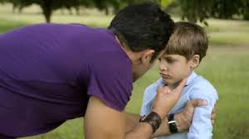
Shame
Guilt versus shame
Sense of being internally flawed
Taught
Early conclusions about self
Early decisions about compensatory behavior
Robs you of intimacy (hide real self)
Limits choices and freedom

Slide 8
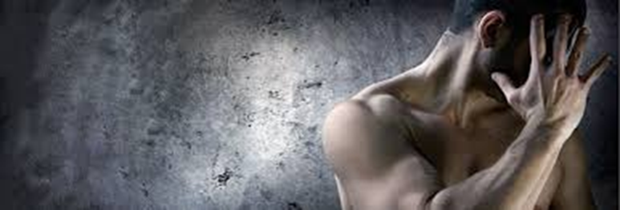
Shame
Continues to manifest in more shame-producing behaviors:
Addictions
Affairs
Eating Disorders
Co-dependency
Become ashamed of the shame
Invisible but pervasive wound

Slide 9
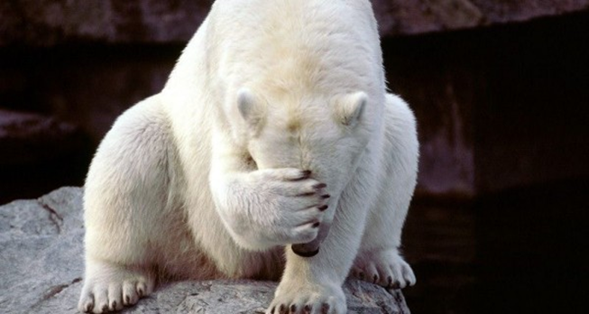
Symptoms of Shame
Moment of shame – body language
Eyes averted
Head lowered
Blushing
Difficulty speaking: stammering, stuttering

Slide 10
Language of Shame
“How could I be so stupid?”
Self-deprecating statements
Inappropriate and extensive apologizing

Slide 11
How Shame Develops
Dysfunctional families/Lack of appropriate boundaries
Family secrets – all members take on shame
Abuse – we take on the shame of the perpetrator
Control – by parents and church

Slide 12
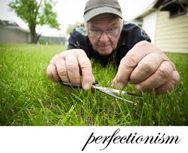
Disguises of Shame
Shyness
Embarrassment
Grandiosity
Excessive modesty
Performance anxiety
Self-consciousness
Perfectionism
Isolation or loneliness
Envy

Slide 13
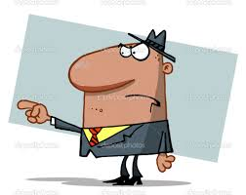
Defenses Against Shame
Anger/Rage
Judgmentalness
Fault-finding or condescending
Blame others when feeling inadequate
Internal withdrawal
Creation of false self to reduce exposure
Maintain façade – mask
Imposter syndrome – will be discovered as “fraud”

Slide 14
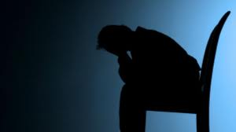
Defenses Against Shame
Depression underlies shame
Go to shame to avoid feelings of:
Helplessness
Failure
Inferiority
Denial of shame or “shameful” situations
Abuse
Addictions
Unfaithfulness
Any disturbing feelings/problems

Slide 15
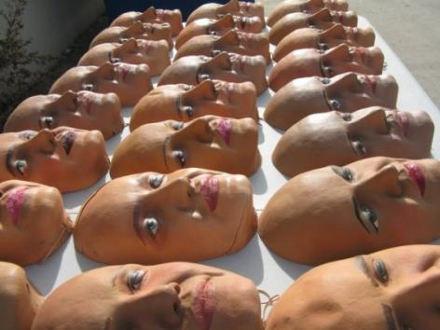
False Self
Child hides/dissociates from differences
Difficulty accepting aspects of self that are different from the majority
Contributes to denial and dissociation from true feelings and needs
Substance use allows expression of suppressed desires and needs
Facilitates denial and dissociation

Slide 16
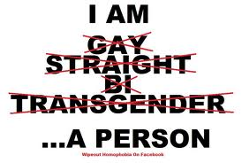
Cultural Homophobia
Cultural norms and institutional policies
Discriminate against LGBT (e.g. marriage, adoption, tax laws, military service, “glass ceiling” in professional settings)
Gender socialization stress
Men: shaming and punishment of other gay males for failing to achieve masculine ideals
Women: more fluid
in gender expression/orientation

Slide 17
Internalized Homophobia
Devalue other LGBT persons
Hide self /monitor behaviors
Assume marginalized group identity
Disassociate (e.g. during sex play)
Lust/love
Overachieve

Slide 18
INTERNALIZED HOMOPHOBIA
Discomfort with one’s homosexuality
Excessive fear and anxiety re discovery
Negative emotional reactions about people who are open
Prejudice and opposition to aspects of LGBT relationships (parenting, public displays)
Rigid conformity to traditional gender roles
“Gay men have become the guys
who bullied us as kids!”
Will this experience differ by generation?

Slide 19
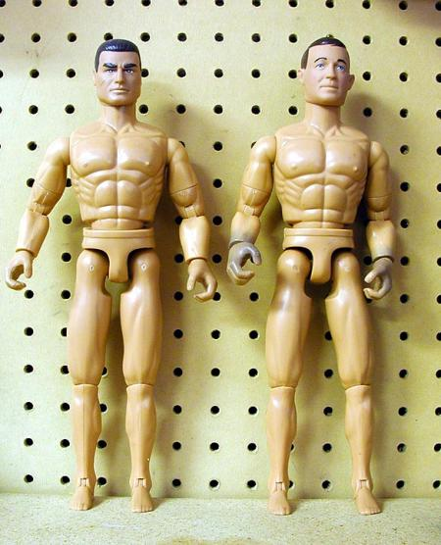
Changes in “Masculinity Ideals”
1964: 12.5” biceps
1994: 26” biceps

Slide 20
Risk factors
􀂃 Sense of self as worthless or bad.
􀂃 Lack of connectedness to supportive adults and peers.
􀂃 Lack of alternative ways to view “differentness”
􀂃 Lack of access to role models.
􀂃 Lack of opportunities to socialize with other gays/lesbians except bars.
􀂃 The risk of contracting HIV and other STIs
Copyright David Fawcett, PhD, LCSW

Slide 21
Shame
The Velvet Rage: Overcoming the Pain of Growing Up Gay in a Straight Man's World
Alan Downs, PhD
Copyright David Fawcett, PhD, LCSW

Slide 22
Stage 1: "Overwhelmed by Shame"
Begins in childhood.
Feeling unloved and flawed
Learns to fake being straight
Receives false rather than authentic validation
Can be sensitive to slightest invalidation
Pushes people away, along with validation so desperately craved.
Can be linked to Trauma/trauma
Copyright David Fawcett, PhD, LCSW

Slide 23
Stage 2: “Compensation of shame”
Longest stage of development
Usually, but not always, out (does not necessarily mean identity crisis solved)
Compensates by becoming the very best and through acquisitions (material, physical, sexual, cultural)
Not satisfied because this validation is still inauthentic.
Eventually results in emptiness and vicious cycle
Copyright David Fawcett, PhD, LCSW

Slide 24
Stage 3: "Discovering Authenticity"
Usually later in life
Search for real meaning, purpose, and integrity.
Least visible stage - likely to withdraw from the clubs and social scene because they aren’t needed for fulfillment.
Copyright David Fawcett, PhD, LCSW

Slide 25
Developing a relationship with self
Inner child
Finding one’s inner strong adult
Changing old core beliefs
Pivotal moments/ trauma/ shock
What conclusions were drawn from that event?
What decisions about behavior were made?
Copyright David Fawcett, PhD, LCSW

Slide 26
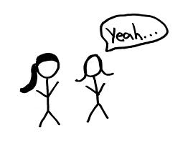
Healing Shame
Group process
Name the shame to release its energy
Release the anger
Can be healed in relationships
Name the person who did the shameful behavior and GIVE IT BACK
Hearing others’ shame
mutual acceptance is healing

Slide 27
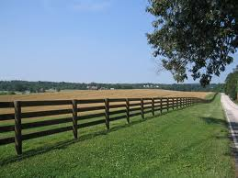
Healing Shame
Individual
Identify what behavior was shamed
Express feelings
Give it back
Construct healthy boundaries
Reclaim personal power “I am innocent”

Slide 28
Healing Shame
Identify shame-based family scripts
Fairy-tale family
Appear healthy at any cost; “let’s pretend;” high performance; avoid conflict
Disconnected family
Avoid conflict; don’t celebrate birthdays or holidays; don’t participate in school events; abandon each other rather than face shame
Rough and tough family
Macho male/passive female; “life is tough;” blame others (gov’t, minorities); defensive; put-downs; masks; no expression except anger

Slide 29
STIGMA

Slide 30
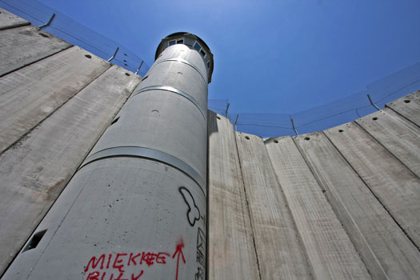
Erving Goffman
Mental patients
Criminals
Homosexuals

Slide 31
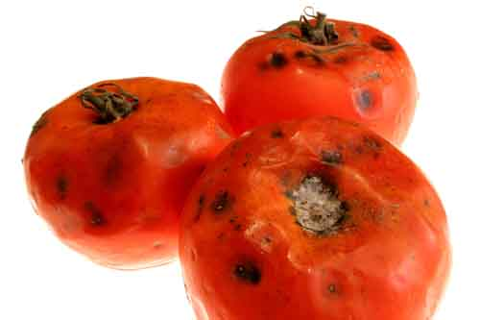
Stigma is… (Goffman)
Dynamic
Result of perceived violation of shared attitudes, beliefs, and values.
"An attribute that is deeply discrediting"
Reduces the bearer "from a whole and usual person to a tainted, discounted one."
“Difference or deviance“ results in a "spoiled identity."

Slide 32
Conceptualizing Stigma
1. Dominant culture distinguishes and labels human differences
2. Links labeled persons to undesirable characteristics (negative stereotypes)
3. Places labeled persons into distinct categories (us versus them)
4. Results in status loss and discrimination

Slide 33
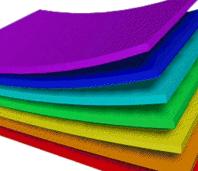
Stigma is Dynamic
Vulnerability varies along trajectory of HIV/AIDS progression
Social context extremely important
poverty, racism, sexism
Overlapping and reinforcing stigmatized conditions.
Double stigma, layers of
stigma, synergistic stigma

Slide 34
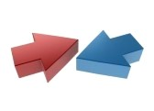
Two sides of stigma
Felt stigma
Real or imagined fear of societal attitudes and potential discrimination
Shame
Survival strategy
Enacted stigma
Actual experience of discrimination

Slide 35
Manifestations of Stigma
Silence and denial
Mild disdain to refusal to treat (among healthcare workers)
eg. the "innocent" victims of AIDS versus the others
Negative judgment
eg. long term survivors about newly infected
Verbal abuse
Physical harm
Banishment
Others?

Slide 36
Discrimination
A consequence of stigma
Unfair treatment based, in the absence of anything objective, on someone belonging to a particular group
Focus on individual and social producers of stigma rather than recipients
Self-imposed discrimination - a priori - as if it has already been imposed

Slide 37
Stigma and HIV/AIDS
Increases HIV risk behavior
people less likely to disclose
Reduces willingness to be tested
Impedes access to prevention, care, treatment
Lowers adherence to treatment and prevention services
Adversely affects health outcomes

Slide 38
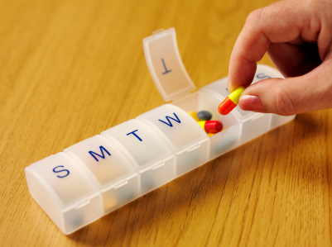
Stigma, testing and treatment
Testing
Reluctance to get tested
Adherence
May miss doses in order to maintain secrecy about HIV status

Slide 39
Measuring stigma

Slide 40
Measures of Stigma
Mostly for research
Few tested and utilized for surveillance
Mostly for United States
Have 2 perspectives:
“stigmatizers” (general public, specific groups, or healthcare workers)
"stigmatized”

Slide 41
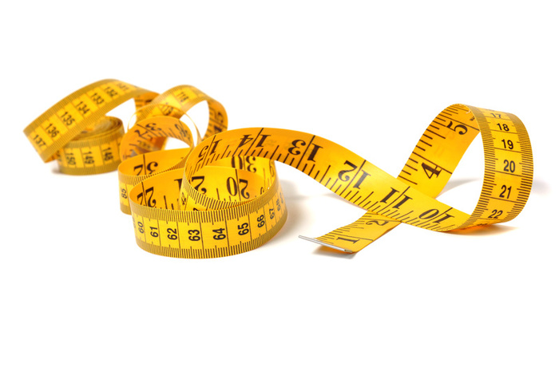
Available Indicators
Social distance
Support for coercive measures
Willingness to interact with stigmatized group
Emotional reactions to stigmatized group

Slide 42
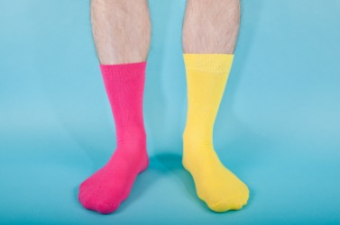
Gaps in Measures
Validation in diverse
populations
Standardization
Ability to capture multiple domains
(pre-existing and overlapping stigmas: commercial sex work; IDU, homosexuality)
Systematic measurement at structural and institutional levels

Slide 43
UNAIDS
Stigma index tool
Requiring use among its core indicators of country-level responses to AIDS

Slide 44
Interventions

Slide 45
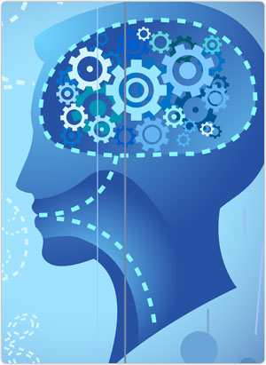
Socio-cognitive interventions
Dominant approach
Information dissemination, empathy induction, counseling, CBT
Increase empathy and altruism
Reduce anxiety and fear

Slide 46
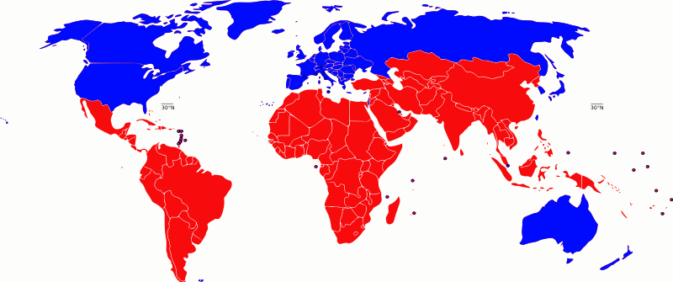
Socio-cognitive interventions
Combined approaches are more effective
Self-identified HIV+ speakers with educational component
Information with skills building
Don't know effectiveness in developing countries

Slide 47
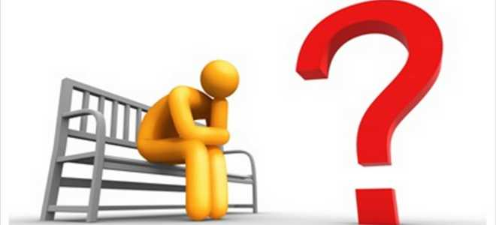
Socio-cognitive interventions
Concerns:
Few psychometric studies
Measures not validated
Excludes structural aspects
social, economic, political processes
Knowledge doesn't necessarily translate to change in attitudes/behaviors

Slide 48
Mass media
Relatively understudied
Can have small positive impact on knowledge of HIV transmission
Small reduction in risk behavior
Can be effective:
Botswana "Bold and the Beautiful"

Slide 49
Structural Approaches
Intersection of culture, power, and difference
Some groups devalued and others are overvalued
Need more institutional/structural interventions relating to dominant groups and power
religious leaders, the judiciary, legislators

Slide 50
Power: reciprocal dynamic
"power is not only needed to enable stigmatization, but … stigmatization plays a key role in producing and reproducing relations of power and control.“

Slide 51
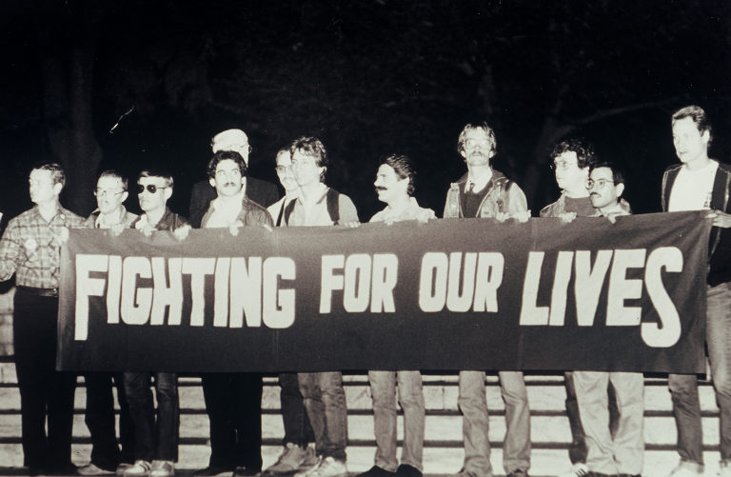
BREAKING OUT OF THE BOX
Denver Principles (1983)
We condemn attempts to label us as "victims," a term which implies defeat, and we are only occasionally "patients," a term which implies passivity, helplessness, and dependence upon the care of others. We are "People With AIDS."

Slide 52
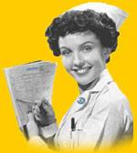
The Professional
Professional characteristics to treat LGBT shame and stigma
Which are helpful?
Which are necessary?

Slide 53
Reframe from deficits-based to strengths-based
From victim to empowered
Deficits-based approaches
Raise condom use skills
(gay men don’t know how to use condoms)
Raise condom negotiation skills
(gay men don’t know how to negotiate sex)
Change peer norms
(gay men have unhealthy peer norms, esp. around sex)
Raise skills to face homophobia
(gay men have few skills to face homophobia)
Copyright David Fawcett, PhD, LCSW

Slide 54
Strengths-based approaches (resilience)
Gay men quit smoking at high rates.
LGBTs report low levels of
problematic drug use given
exposure rates.
LGBTs can resolve heavy substance use over time.
Large proportions of gay men stay seronegative for decades on end, even while enjoying a very active sexual life

Slide 55
LGBT opinions about S.A. treatment
Address substance abuse and sexual orientation directly, rather than wait for clients to bring it up
Be knowledgeable about addiction and sexual orientation and how these two interact.
Provide gay/lesbian specific meetings and groups, which provide opportunities for sober role models (connection, identification, and safety)
Copyright David Fawcett, PhD, LCSW

Slide 56
Opinions about treatment
Help clients move through shame to self acceptance
Atmosphere of acceptance is healing
Sensitivity to client choice
Can they safely come out to staff and peers?

Slide 57
Opinions about Treatment
Know the social context of behaviors within the gay community.
Be aware of the high risk of suicide in the gay community
One man hospitalized himself for suicidal depression and the facility addressed neither his addiction nor his sexual orientation.
Copyright David Fawcett, PhD, LCSW

Slide 58
Contact
David Fawcett
2655 East Oakland Park Blvd
Suite 2
Fort Lauderdale, Florida 33306
954.776.3639
www.david-fawcett.com
davidfawcett@earthlink.net

