Slide 1
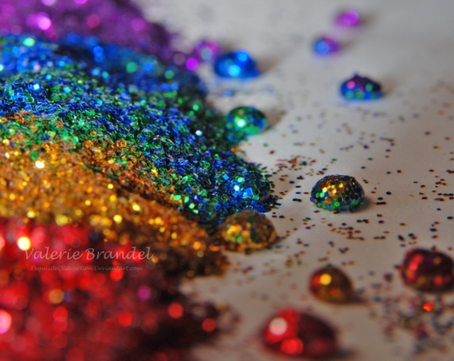
Clinical Implications of DSM 5 for LGBT Care: Addictions and Coping
David Fawcett PhD, LCSW
10th Annual Conference for Mental Health
and Nursing Professionals
Sunserve

Slide 2
Agenda
Epidemiology
Social Context of Addiction
Drugs of Abuse
DSM 5
Treatment and Recovery
Case Studies

Slide 3
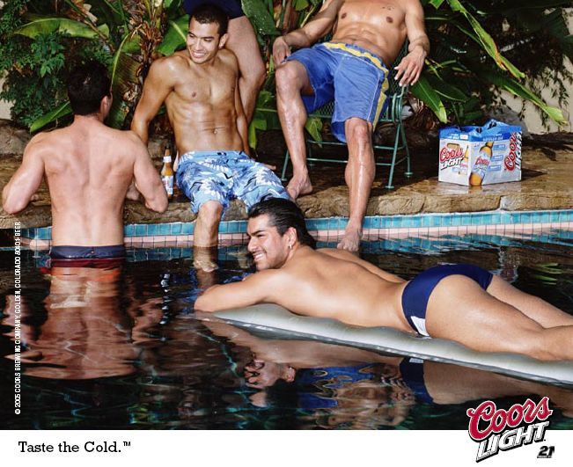

Slide 7
Epidemiology

Slide 8
Epidemiology
How are LGBT addicts different than straight addicts?
1970s Rates as high as 30%
1980s Homosexual drinking 19%
Heterosexual drinking 11%
(San Francisco)
Gay men more likely than heterosexual men to use and abuse recreational drugs:
1/3 gay men use drugs 1x/week
What drugs?
2/3 used in past 6 months

Slide 9
Epidemiology – Data Sources
National Household Survey on Drug Abuse &Monitoring the Future Study
does not include sexual orientation or gender identity as demographic variables
Studies of alcohol and other drug use in the LGBT community focused primarily on lesbians and gay men
Few have been designed specifically to include bisexual or transgender persons.
www.gaydata.org

Slide 10
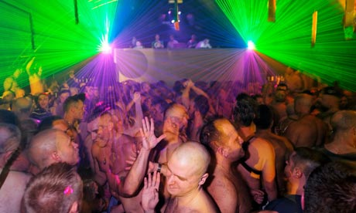
Epidemiology
Alcoholism and drug abuse affect LGBT persons at 2-3 times the rate of the general population

Slide 11
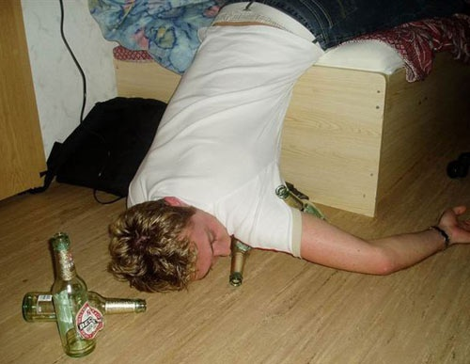
Epidemiology - Youth
Age at first alcohol or drug use is younger in gays and lesbians
Among gay male adolescents:
68% reported alcohol use (with 26% using alcohol once or more per week)
44% reported drug use (with 8% considering themselves drug-dependent)

Slide 12
Epidemiology – Gay Men
(April 2000 Millennium March in Washington, D.C.)
“How often are party drugs used in your close circle of friends?”
26.3% used party drugs once a month
21.9% used one or two times a year
38.4% never used in their circle of friends
(Illicit drug use – not just party: 26% of gen pop – SAMHSA)

Slide 13
Epidemiology- Lesbians
(K-Y Community Health Survey (307 self-identified lesbians)
“How often are party drugs used in your close circle of friends?”
61.9% never used party drugs
But growing evidence of party drug use among lesbians

Slide 14
Epidemiology - Lesbians
(Curtin University, Australia 2010)
33% use tobacco (16% general pop)
49% used illicit drugs in prior year
36% marijuana
18% ecstasy
16% amphetamines
35% had anti-gay harassment in prior year
20% had domestic violence with partner

Slide 15
Epidemiology - Transgender Women
(209 transgender women)
Past month use:
37% used alcohol (heavy drinking 6% gen pop)
13% used marijuana
11% used methamphetamine
11% used crack
7% used powdered cocaine
2% used heroin
Copyright David Fawcett, PhD, LCSW

Slide 16
Epidemiology – suicide risk
Self harm and suicide
Gay men 7x more likely to have attempted suicide
Gay youth comprise 30% of completed suicides annually
Gay and bisexual men have higher rates of deliberate self-harm
[John Grant, MD, PhD, U Minn.]

Slide 17
LGBT IDENTITY
SOCIAL CONTEXT OF ADDICTION

Slide 18
Historical Perspectives
1940s through 1960s
Same-sex sexual attraction and behavior was a mental disorder
1957
Dr. Evelyn Hooker’s landmark study finds gays and lesbians “normal”
1973
The American Psychiatric Association removes homosexuality as psychopathology from the DSM

Slide 19
Stigma is Dynamic
Addict, gay, HIV, disabled, sex worker, homeless…
Social context extremely important
poverty, racism, sexism
Overlapping and reinforcing stigmatized conditions.
Double stigma, layers of
stigma, synergistic stigma

Slide 20
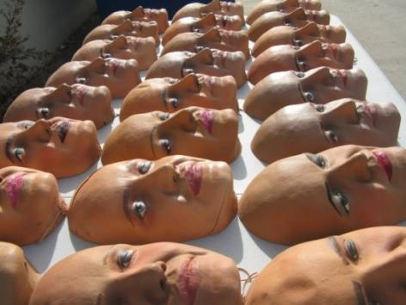
False Self
Child hides/dissociates from differences
Difficulty accepting aspects of self that are different from the majority
Substance use allows expression of suppressed desires and needs
Facilitates denial and dissociation

Slide 21
Cultural Homophobia
Cultural norms
and institutional policies
Discriminate against LGBT (e.g. marriage, adoption, tax laws, military service, “glass ceiling” in professional settings)
Gender socialization stress
Men: shaming and punishment of other gay males for failing to achieve masculine ideals
Women: more fluid
in gender expression/orientation

Slide 22
Internalized Homophobia
Devalue other LGBT persons
Hide self /monitor behaviors
Assume marginalized group identity
Disassociate (e.g. during sex play)
Lust/love
Overachieve
Discomfort with one’s homosexuality
Excessive fear and anxiety re discovery
Negative emotional reactions about people who are open
Prejudice and opposition to aspects of LGBT relationships (parenting, public displays)
Rigid conformity to traditional gender roles
Will this experience differ by generation?

Slide 23
Risk factors
Sense of self as worthless or bad.
Lack of connectedness to supportive adults and peers.
Lack of alternative ways to view “differentness”
Lack of access to role models.
Lack of opportunities to socialize with other gays/lesbians except bars.
The risk of contracting HIV and other STIs

Slide 24
Drugs of Abuse

Slide 25
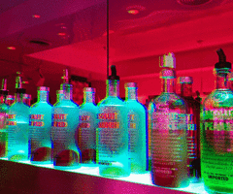
Alcohol
Gay bar is primary source of social contact
Refuge from judgment and heteronegativity
Remains a significant social center for LGBT youth
More so in rural areas

Slide 27
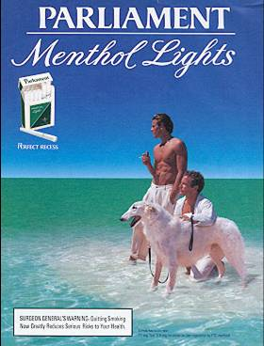
Tobacco
http://lgbttobacco.org
More likely to smoke than
general population
Specific targeting by tobacco industry
American Lung Association 2009:
Gay men 1.1 to 2.4 odds of smoking
Lesbians 1.2 to 2.0 odds
Bisexuals 1.3 and up
Transgender – no data

Slide 28
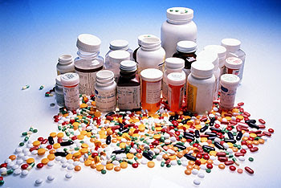
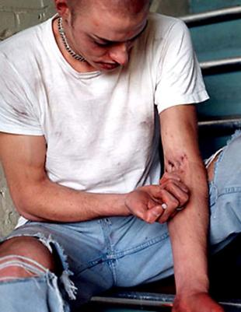
Opiates
Prescription Medication
Rx opiate deaths surpass
cocaine and heroin combined
Heroin
Many rx med users go to heroin due to availability and/or cost

Slide 29
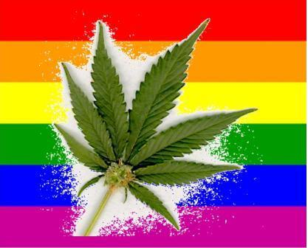
Marijuana
High rates of use in LGBT community
Medical marijuana (HIV)
Marinol/THC
Smoke toxins
Higher rates testicular cancer

Slide 30
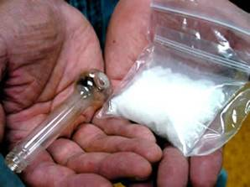
Amphetamines
Powdered cocaine
Crack cocaine
Methamphetamine
Highly addictive
Highly sexual
Increased HIV risk
Bath salts
MPVD/mephedrone
4x stronger than Ritalyn

Slide 31
Natural Rewards Elevate Dopamine Levels
FOOD
SEX
200
200
NAc shell
150
150
DA Concentration (% Baseline)
100
100
15
% of Basal DA Output
Empty
10
50
Copulation Frequency
Box
Feeding
5
0
0
0
60
120
180
Scr
Scr
Scr
Scr
Time (min)
Bas
Female 1 Present
Female 2 Present
Sample
Number
1
2
3
4
5
6
7
8
9
10
11
12
13
14
15
16
17
Mounts
Intromissions
Ejaculations
Source: Di Chiara et al.
Source: Fiorino and Phillips

Slide 32
Effects of Drugs on Dopamine Levels
250
NICOTINE
COCAINE
400
Accumbens
200
Accumbens
Caudate
300
DA
150
DOPAC
% of Basal Release
% of Basal Release
HVA
100
200
100
0
0
1
2
3 hr
0
0
1
2
3
4
5 hr
Time After Nicotine
Time After Cocaine
AMPHETAMINE
1100
Accumbens
1000
900
800
DA
700
DOPAC
% of Basal Release
HVA
600
500
400
300
200
100
0
0
1
2
3
4
5 hr
Source: Di Chiara and Imperato
Time After Amphetamine

Slide 33
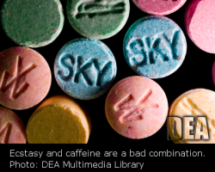
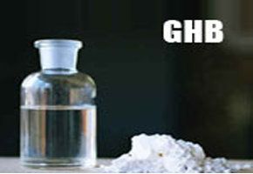
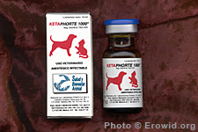
“Club” Drugs
X – Ecstasy
MDMA
Mollys
Mephedrone
G – Gamma Hydroxybutirate
Anesthetic
K – Ketamine
Veterinary anesthetic
Circuit parties

Slide 34
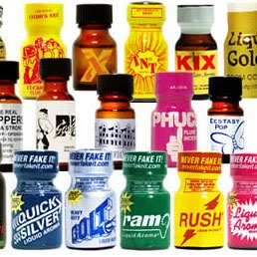
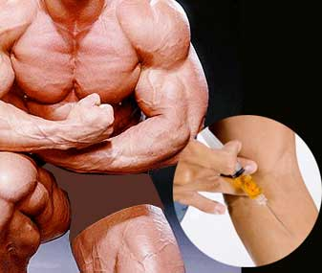
Others
Poppers
Amyl nitrate, butyl nitrate
Dangerous with antihypertensives,
PDE-5 inhibitors
Steroids

Slide 35
Process Addictions
Sex addiction
Gambling
Video games
Shopping
Internet
Work
Exercise

Slide 36
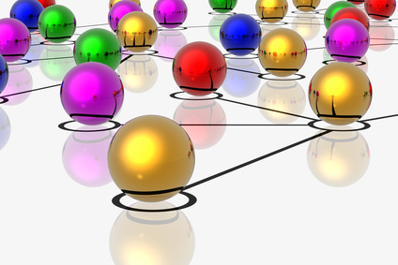
Syndemics
2 or more epidemics interacting simultaneously and synergistically (having a greater effect than would be expected by adding the effects of each.

Slide 37
DSM 5

Slide 38
DSM IV to DSM 5
Substance Abuse and Substance Dependence merged to become Substance Use Disorder
Based on 11 criteria; more criteria = more severe
As in DSM-IV
Specifiers reflect physiologic dependence and course of illness

Slide 39
Phenomena Modulating Addiction
Vulnerability
Sustained exposure to addicting drugs
Genes, environment, behavioral interactions
Motivational shift
Pleasure to craving
Aberrant learning
Dopamine activates the direct Go pathway and inhibits the indirect No-Go pathway.
Move to reflexive, rather than planned decisions

Slide 40
Addiction
Pleasure
Release of dopamine in nucleus accumbens
Likelihood of drug use
Related to speed with which if promotes release of dopamine
Dopamine hijacks brain’s reward circuitry
Addictive drugs release 10x dopamine
Compared with natural rewards

Slide 41
Addiction
Over time dopamine creates less reward
Compulsion takes over to recreate the memory of pleasure
Environmental cues receive more salience
Overall relapse rate of 60%
Similar to hypertension and asthma

Slide 42
10 Separate Classes of Drugs (not fully distinct)
Alcohol
Caffeine
(only intoxication and withdrawal, not substance use disorder)
Cannabis
Hallucinogens
(separate categories for PCP and others)
Inhalants
Opioids
Sedatives, hypnotics, and anxiolytics
Stimulants
(amphetamine-like substances, cocaine, and others)
Tobacco
Other (or unknown) substances

Slide 43
New Disorders in DSM 5
Cannabis Withdrawal
Caffeine Withdrawal
(was in DSM IV appendix for further study)

Slide 44
Diagnostic Criteria
Group A. Impaired control over substance use
1. Larger amounts and over long time than intended
2. Desire to cut down/quit and may report unsuccessful efforts to regulate use
3. Great deal of time spent obtaining, using, and recovering
4. Craving – an intense desire or urge for the drug

Slide 45
Diagnostic Criteria
Group B. Social Impairment
5. Failure to meet role obligations at school, work, or home
6. Continued use despite persistent or recurrent social or interpersonal problems
7. Important social, occupational, recreational activities my be given up

Slide 46
Diagnostic Criteria
Group C. Risky Use
8. Recurrent use in situations where it is physically hazardous
9. Recurrent use despite knowledge that a physical or psychological problem is likely caused or aggravated
(not the existence of a problem but the failure to abstain)

Slide 47
Diagnostic Criteria
Group D. Pharmacological criteria
10. Tolerance: a marked increase in dose to achieve the same desired effect
11. Withdrawal
(except for phencyclidine, other hallucinogens, or inhalants)
Note: neither tolerance nor withdrawal are necessary for a diagnosis of substance use

Slide 48
Substance Use Severity
Based on the number of criteria endorsed
Mild
Presence of 2 – 3 criteria
Moderate
Presence of 4 -5 criteria
Severe
Presence of 6 or more criteria

Slide 49
Specifiers
In Early Remission
At least 3 but less than 12 months without meeting criteria (except craving)
In Sustained Remission
At least 12 months without meeting criteria (except craving)
New specifiers:
“In a controlled environment”
“On maintenance therapy”

Slide 50
DSM IV to DSM 5
Deleted:
Recurrent substance-abuse related legal problems criterion
Added:
Craving, or a strong desire to use a substance

Slide 51
DSM IV to DSM 5
Changed from DSM IV:
Old criteria threshold for Substance Abuse
One or more
Old criteria threshold for Substance Dependence
Three or more
New in DSM 5 for Substance Use Disorder:
Two or more criteria

Slide 52
DSM IV to DSM 5
Eliminated:
DSM IV specifier for physiological subtype
DSM IV dx: Polysubstance Dependence

Slide 53
Recording
Use code for class of substances but record specific substance
Moderate alprazolam use disorder 301.10
Rather than “moderate sedative, hypnotic, or anxiolytic use disorder”
Mild methamphetamine use disorder 305.70
Rather than “mild stimulant use disorder”
For substances that don’t fit a class (eg anabolic steroids) use “other substance use disorder”

Slide 54
Recording
If criteria met for more than one class or drug, all should be recorded
“Addiction” is not used in the DSM 5

Slide 55
Substance-Induced Disorders
Intoxication
Withdrawal
Other substance/medication-induced disorders
(eg induced psychotic or depressive disorders)

Slide 56
Gambling Disorder
Activates brain’s reward system in similar ways as substances
Other behavioral addictions await further peer-reviewed study and are not included:
Internet gaming
Sex addiction
Exercise addiction
Shopping addiction

Slide 57
Pathological Gambling
Pathological gamblers
Manifest tolerance, dependence and withdrawal
Have comorbid substance abuse (30-50%)
Same genetic markers for PG and SA
Display changes in neural circuits

Slide 58
Adolescent Gambling
80-85% gamble socially
Mostly male, avg age of onset 12, social motivation rather than money
10-14% gamble at expense of other social activities
Internet gambling a concern
4-8% persistent and recurrent PG
Can progress to PG more rapidly than adults
(12-14 months)

Slide 59
Treatment and Recovery

Slide 60
Treatment
Similar physical protocols
Need safe treatment environment
Overt/covert messaging by staff
Recognize drug-specific differences/ needs
Opiates versus amphetamines
Meth – for example, CBT “lite”
Ease of transfer – for example, process addictions
Copyright David Fawcett, PhD, LCSW

Slide 61
How is the LGBT recovery process different?
Issues for >6 months recovery
Physical recovery and co-occurring disorders
Shame and stigma
Sex and intimacy concerns
Rebuilding identity

Slide 62
Physical Recovery and Co-Occurring Disorders
PAWS (Post Acute Withdrawal Syndrome)
Trouble thinking clearly/ concentrating
Mood swings; emotional overreaction or numbness
Memory problems
Sleep disturbances
Physical coordination problems
Difficulty managing stress
Rigid, repetitive thinking

Slide 63
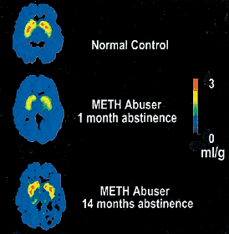
Physical Recovery and Co-Occurring Disorders
PAWS
Results from:
GABA-agonist (benzos, barbs, ethanol, GHB)
Opioid dependence
Amphetamine dependence (dopamine transporter system repair)
Duration 1 year to indefinite

Slide 64
Treatment and Supports
12 step programs
AA, NA, CMA
SMART Recovery
www.smartrecovery.org
Harm Reduction
www.harmreduction.org
Various levels of treatment

Slide 65
Tool kit
Stages of Change
Precontemplation
Contemplation
Preparation
Action
Maintenance
Motivational Interviewing

Slide 66
Psychosocial Co-Factors
Social Disinhibition
Cope with negative social meanings of gay
Second “coming out”
Overcome inhibition
Particularly sexual
Conflicting social norms
Social activities involving substances

Slide 67
Psychosocial Co-Factors
Identity
Slammers
Clubkids
Tribe
Barebackers
Obtain self esteem through sex
Boredom
Copyright David Fawcett, PhD, LCSW

Slide 68
Psychosocial Co-Factors
Shame
Long term
Internalized Homophobia
Relationship with self
“No fats, no fems”
“No fakes, no flakes, no fruity-cakes”
“Str8 acting UB2”
“d/d free”
Copyright David Fawcett, PhD, LCSW

Slide 69
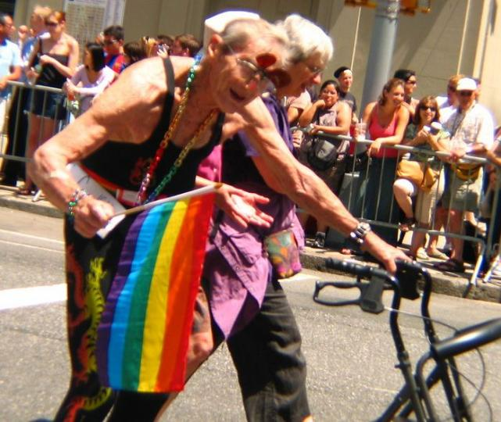
Psychosocial Co-Factors
Dealing with feelings
Cognitive Escapism and Social Leveling
Loneliness
Attractiveness
Ageism

Slide 70
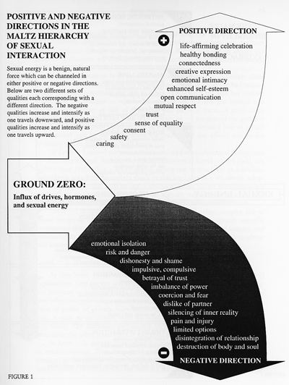
Sex
What is
healthy sex?
Copyright David Fawcett, PhD, LCSW

Slide 71
Psychosocial Co-Factors
Intimacy
Romance is not intimacy
Limerance
Oxytocin, vasopressin
LUST
LOVE
LUST
LOVE
Copyright David Fawcett, PhD, LCSW
Notes:
QUESTIONS?

Slide 72
Building a Healthy Identity

Slide 73
Relationship with self
Inner child
Finding one’s inner strong adult
Changing old core beliefs
Pivotal moments/ trauma/ shock
What conclusions were drawn from that event?
What decisions about behavior were made?

Slide 74
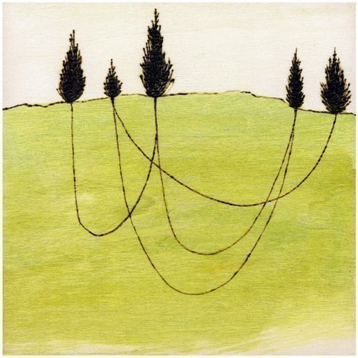
Connections
Friendships and Community
Need non-commercial connections
NSBF (no sex best friend)
Good and bad of the internet
Recreation

Slide 75
Move Beyond Labels
Noodlesandbeef.com

Slide 76
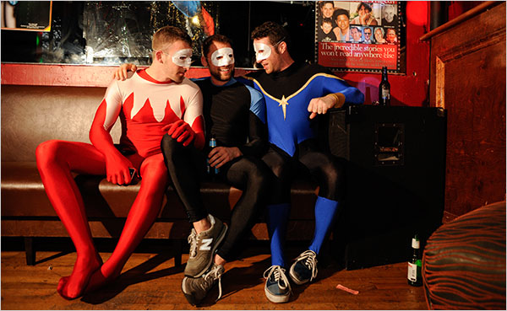
Interpersonal Strengths
Social Bonding
Sense of Community
Practice Dating/Sex/Intimacy/Relationships
Healthy Sense of Being LGBTQI…
Spirituality

Slide 77
Case Studies

Slide 78
Contact
David Fawcett PhD, LCSW
2655 E. Oakland Park Blvd, Ste 2
Fort Lauderdale FL 33306
954-776-3639
davidfawcett@earthlink.net

