Slide 1
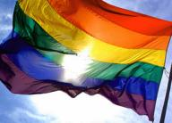
ADDICTIVE BEHAVIORS AND THE LGBT CLIENT
David Fawcett PhD, LCSW

Slide 2
Agenda
Welcome/Overview
Epidemiology
LGBT identity
Substances and behaviors
Syndemics: mental health and HIV
Case study
Treatment and recovery
Role of the professional
Summary
Copyright David Fawcett, PhD, LCSW

Slide 3
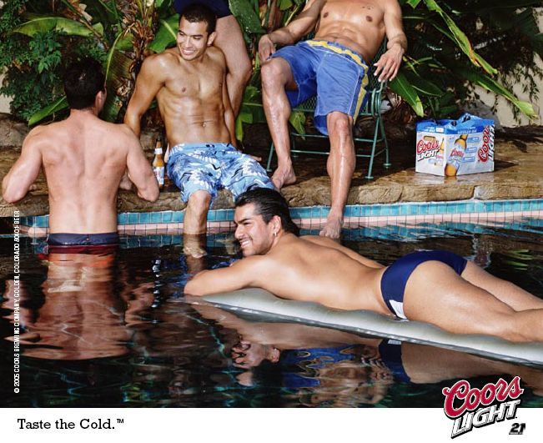

Slide 7
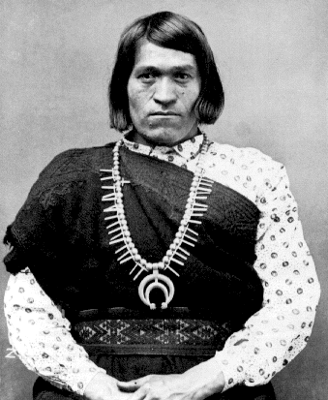
Terminology
Sex
Anatomy
Gender
Concept of femininity/masculinity
Gender role: behaviors/desire to act
Gender identity
Self concept – not always derived from anatomy
Not always binary..two spirit
Sexual orientation
Most don’t see as preference
Queer
Along the spectrum
Copyright David Fawcett, PhD, LCSW

Slide 8
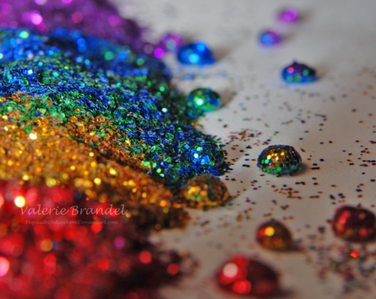
Epidemiology

Slide 9
Epidemiology
How are LGBT addicts different than straight addicts?
1970s Rates as high as 30%
1980s Homosexual drinking 19%
Heterosexual drinking 11%
(San Francisco)
Gay men more likely than heterosexual men to use and abuse recreational drugs:
1/3 gay men use drugs 1x/week
What drugs?
2/3 used in past 6 months
Copyright David Fawcett, PhD, LCSW

Slide 10
Epidemiology – Data Sources
National Household Survey on Drug Abuse &Monitoring the Future Study
does not include sexual orientation or gender identity as demographic variables
Studies of alcohol and other drug use in the LGBT community focused primarily on lesbians and gay men
Few have been designed specifically to include bisexual or transgender persons.
www.gaydata.org
Copyright David Fawcett, PhD, LCSW

Slide 11
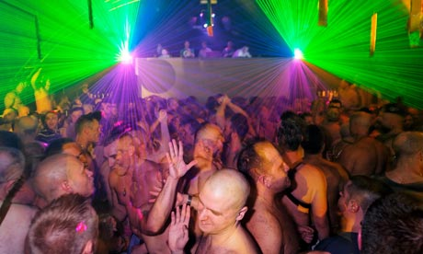
Epidemiology
Alcoholism and drug abuse affect LGBT persons at 2-3 times the rate of the general population
Copyright David Fawcett, PhD, LCSW

Slide 12
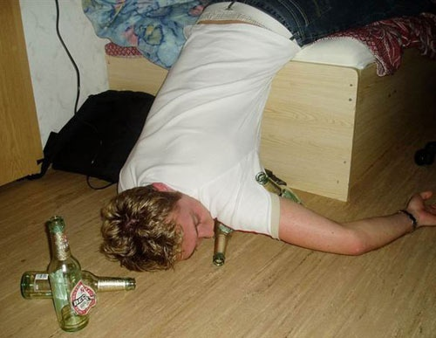
Epidemiology - Youth
Age at first alcohol or drug use is younger in gays and lesbians
Among gay male adolescents:
68% reported alcohol use (with 26% using alcohol once or more per week)
44% reported drug use (with 8% considering themselves drug-dependent)
Copyright David Fawcett, PhD, LCSW

Slide 13
Epidemiology - Youth
Those who identify as LGBT; had same-sex experiences; or who are perceived by their peers to be LGBT have significantly higher prevalence use
CDC Youth Risk Behavior Survey
LGBT youth were more likely to be victimized, threatened, and engage in a variety of risk behaviors, including suicidal ideation and attempts as well as high-risk sexual behavior
Copyright David Fawcett, PhD, LCSW

Slide 14
Epidemiology – Gay Men
(April 2000 Millennium March in Washington, D.C.)
“How often are party drugs used in your close circle of friends?”
13.4% used party drugs one or more times a week
26.3% used party drugs once a month
21.9% used one or two times a year
38.4% never used in their circle of friends
(Illicit drug use – not just party: 26% of gen pop – SAMHSA)
Copyright David Fawcett, PhD, LCSW

Slide 15
Epidemiology- Lesbians
(K-Y Community Health Survey (307 self-identified lesbians)
“How often are party drugs used in your close circle of friends?”
5.9% used party drugs one or more times a week
11.4% used party drugs once a month
20.8% used party drugs one or two times a year.
61.9% never used party drugs
Growing evidence of party drug use among lesbians
Copyright David Fawcett, PhD, LCSW

Slide 16
Epidemiology - Lesbians
(Curtin University, Australia 2010)
33% use tobacco (16% general pop)
49% used illicit drugs in prior year
36% marijuana
18% ecstasy
16% amphetamines
35% had anti-gay harassment in prior year
20% had domestic violence with partner
Copyright David Fawcett, PhD, LCSW

Slide 17
Epidemiology - Transgender Women
(209 transgender women)
Past month use:
37% used alcohol (heavy drinking 6% gen pop)
13% used marijuana
11% used methamphetamine
11% used crack
7% used powdered cocaine
2% used heroin
Copyright David Fawcett, PhD, LCSW

Slide 18
Epidemiology – suicide risk
Self harm and suicide
Gay men 7x more likely to have attempted suicide
Gay youth comprise 30% of completed suicides annually
Gay and bisexual men have higher rates of deliberate self-harm
[John Grant, MD, PhD, U Minn.]
Copyright David Fawcett, PhD, LCSW

Slide 19
LGBT IDENTITY
SOCIAL CONTEXT OF ADDICTION

Slide 20
Historical Perspectives
1940s through 1960s
Same-sex sexual attraction and behavior was a mental disorder
1957
Dr. Evelyn Hooker’s landmark study finds gays and lesbians “normal”
1973
The American Psychiatric Association removes homosexuality as psychopathology from the DSM
Copyright David Fawcett, PhD, LCSW

Slide 21
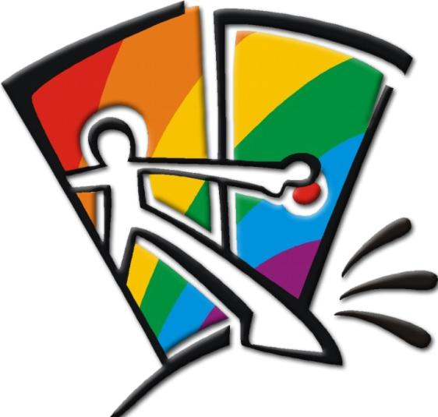
Developmental Models
Linear
Cass
Non-linear
D’Augelli
Medical
WPATH (Harry Benjamin)
Feminist, Post-modern, Queer
Narrative, Solution Focused, etc.
Copyright David Fawcett, PhD, LCSW

Slide 22
Two sides of stigma
Felt stigma
Real or imagined fear of societal attitudes and potential discrimination
Shame
Survival strategy
Enacted stigma
Actual experience of discrimination
Copyright David Fawcett, PhD, LCSW

Slide 23
Stigma is Dynamic
Addict, gay, HIV, disabled, sex worker, homeless…
Social context extremely important
poverty, racism, sexism
Overlapping and reinforcing stigmatized conditions.
Double stigma, layers of
stigma, synergistic stigma
Copyright David Fawcett, PhD, LCSW

Slide 24
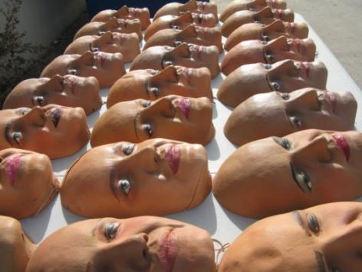
False Self
Child hides/dissociates from differences
Difficulty accepting aspects of self that are different from the majority
Contributes to denial and dissociation from true feelings and needs
Substance use allows expression of suppressed desires and needs
Facilitates denial and dissociation

Slide 25
Internalized Homophobia
Devalue other LGBT persons
Hide self /monitor behaviors
Assume marginalized group identity
Disassociate (e.g. during sex play)
Lust/love
Overachieve
Discomfort with one’s homosexuality
Excessive fear and anxiety re discovery
Negative emotional reactions about people who are open
Prejudice and opposition to aspects of LGBT relationships (parenting, public displays)
Rigid conformity to traditional gender roles
Will this experience differ by generation?

Slide 26
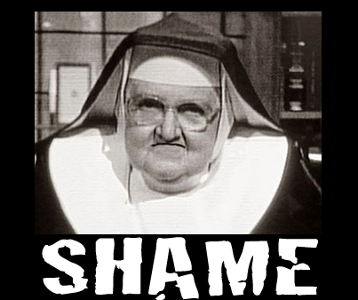
Cultural Homophobia
Cultural norms and institutional policies
Discriminate against LGBT (e.g. marriage, adoption, tax laws, military service, “glass ceiling” in professional settings)
Gender socialization stress
Men: shaming and punishment of other gay males for failing to achieve masculine ideals
Women: more fluid
in gender expression/orientation
Copyright David Fawcett, PhD, LCSW

Slide 27
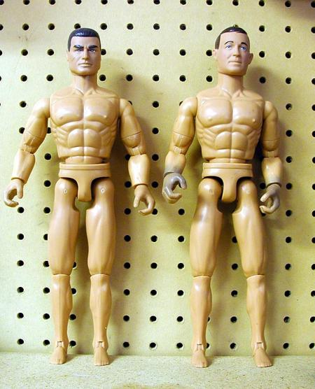
Changes in “Masculinity Ideals”
1964: 12.5” biceps
1994: 26” biceps
Copyright David Fawcett, PhD, LCSW

Slide 28
Shame
The Velvet Rage: Overcoming the Pain of Growing Up Gay in a Straight Man's World
Alan Downs, PhD
Copyright David Fawcett, PhD, LCSW

Slide 29
Stage 1: "Overwhelmed by Shame"
Begins in childhood.
Feeling unloved and flawed
Learns to fake being straight
Receives false rather than authentic validation
Can be sensitive to slightest invalidation
Pushes people away, along with validation so desperately craved.
Can be linked to Trauma/trauma
Copyright David Fawcett, PhD, LCSW

Slide 30
Stage 2: “Compensation of shame”
Longest stage of development
Usually, but not always, out (does not necessarily mean identity crisis solved)
Compensates by becoming the very best and through acquisitions (material, physical, sexual, cultural)
Not satisfied because this validation is still inauthentic.
Eventually results in emptiness and vicious cycle
Copyright David Fawcett, PhD, LCSW

Slide 31
Stage 3: "Discovering Authenticity"
Usually later in life
Search for real meaning, purpose, and integrity.
Least visible stage - likely to withdraw from the clubs and social scene because they aren’t needed for fulfillment.
Copyright David Fawcett, PhD, LCSW

Slide 32
Developing a relationship with self
Inner child
Finding one’s inner strong adult
Changing old core beliefs
Pivotal moments/ trauma/ shock
What conclusions were drawn from that event?
What decisions about behavior were made?
Copyright David Fawcett, PhD, LCSW

Slide 33
Risk factors
􀂃 Sense of self as worthless or bad.
􀂃 Lack of connectedness to supportive adults and peers.
􀂃 Lack of alternative ways to view “differentness”
􀂃 Lack of access to role models.
􀂃 Lack of opportunities to socialize with other gays/lesbians except bars.
􀂃 The risk of contracting HIV and other STIs
Copyright David Fawcett, PhD, LCSW

Slide 34
Gratuitous cute puppy photo

Slide 35
Drugs of Abuse

Slide 36
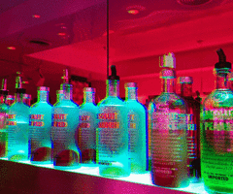
Alcohol
Gay bar is primary source of social contact
Refuge from judgment and heteronegativity
Remains a significant social center for LGBT youth
More so in rural areas
Copyright David Fawcett, PhD, LCSW

Slide 38
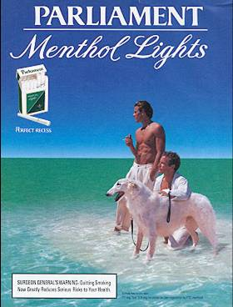
Tobacco
http://lgbttobacco.org
More likely to smoke than general population
Specific targeting by tobacco industry
American Lung Association 2009:
Gay men 1.1 to 2.4 odds of smoking
Lesbians 1.2 to 2.0 odds
Bisexuals 1.3 and up
Transgender – no data
Copyright David Fawcett, PhD, LCSW

Slide 39
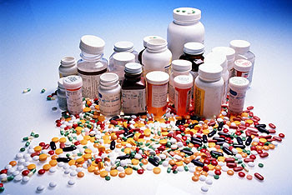
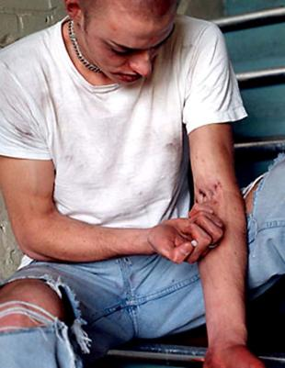
Opiates
Prescription Medication
Rx opiate deaths surpass
cocaine and heroin combined
Heroin
Many rx med users go to heroin due to availability and/or cost
Copyright David Fawcett, PhD, LCSW

Slide 40
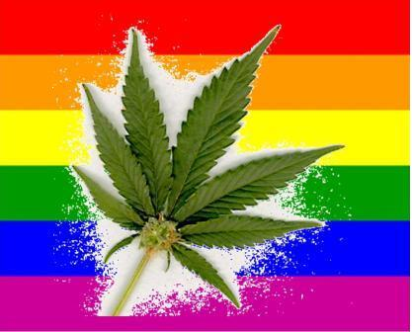
Marijuana
High rates of use in LGBT community
Medical marijuana (HIV)
Marinol/THC
Smoke toxins
Higher rates testicular cancer
Copyright David Fawcett, PhD, LCSW

Slide 41
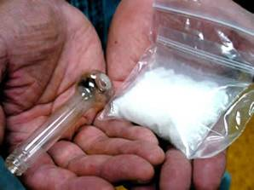
Amphetamines
Powdered cocaine
Crack cocaine
Methamphetamine
Highly addictive
Highly sexual
Increased HIV risk
Bath salts
MPVD/mephedrone
4x stronger than ritalyn

Slide 42
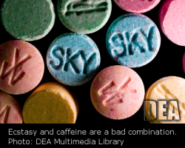
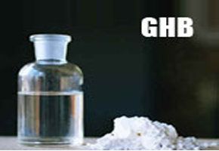
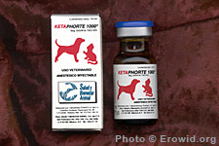
“Club” Drugs
X – Ecstasy
MDMA
G – Gamma Hydroxybutirate
Anesthetic
K – Ketamine
Veterinary anesthetic
Circuit parties
Copyright David Fawcett, PhD, LCSW

Slide 43
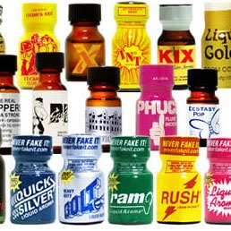
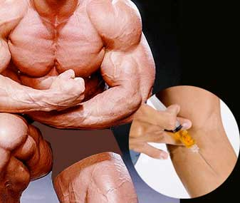
Others
Poppers
Amyl nitrate, butyl nitrate
Dangerous with antihypertensives,
PDE-5 inhibitors
Steroids
Copyright David Fawcett, PhD, LCSW

Slide 44
Process Addictions
Sex addiction
Gambling
Video games
Shopping
Internet
Work
Exercise
DSM 5 Behavioral Addictions? (only gambling)
Copyright David Fawcett, PhD, LCSW

Slide 45
Co-Occurring or Concurrent Addictions
Anne Wilson Schaef - “Addictions rarely, if ever, exist in isolation”
Pat Carnes - “It may be one of the greatest, unacknowledged contributions to recidivism in alcoholism is the failure of treatment programs to treat multiple addictions.”
Copyright David Fawcett, PhD, LCSW

Slide 46
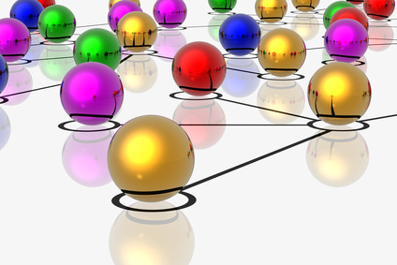
Syndemics
2 or more epidemics interacting simultaneously and synergistically (having a greater effect than would be expected by adding the effects of each.
http://www.cdc.gov/syndemics/overview-principles.htm
Copyright David Fawcett, PhD, LCSW

Slide 47
Case Study Part 1

Slide 48
Break

Slide 49
Focus on Methamphetamine

Slide 50
“Remember when we only had black & white tv? Then came color tv-- it’s the same with methamphetamine and sex”

Slide 51
Natural Rewards Elevate Dopamine Levels
FOOD
SEX
200
200
NAc shell
150
150
DA Concentration (% Baseline)
100
100
15
% of Basal DA Output
Empty
10
50
Copulation Frequency
Box
Feeding
5
0
0
0
60
120
180
Scr
Scr
Scr
Scr
Time (min)
Bas
Female 1 Present
Female 2 Present
Sample
Number
1
2
3
4
5
6
7
8
9
10
11
12
13
14
15
16
17
Mounts
Intromissions
Ejaculations
Source: Di Chiara et al.
Source: Fiorino and Phillips

Slide 52
Effects of Drugs on Dopamine Levels
250
NICOTINE
COCAINE
400
Accumbens
200
Accumbens
Caudate
300
DA
150
DOPAC
% of Basal Release
% of Basal Release
HVA
100
200
100
0
0
1
2
3 hr
0
0
1
2
3
4
5 hr
Time After Nicotine
Time After Cocaine
AMPHETAMINE
1100
Accumbens
1000
900
800
DA
700
DOPAC
% of Basal Release
HVA
600
500
400
300
200
100
0
0
1
2
3
4
5 hr
Source: Di Chiara and Imperato
Time After Amphetamine

Slide 53
Meth
Slang names
Tina, ice, crystal, fire, speed
Ingestion
Snort, smoke, booty bump, slam
Copyright David Fawcett, PhD, LCSW

Slide 54
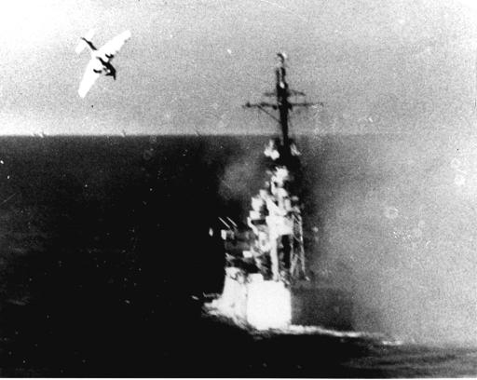
History of Meth
1940s
Japanese soldiers use meth
Nazi soldiers use meth
Pervitin
Hitler a meth addict
Allied soldiers use meth
5 meth tablets in each soldier’s kit
Copyright David Fawcett, PhD, LCSW

Slide 55
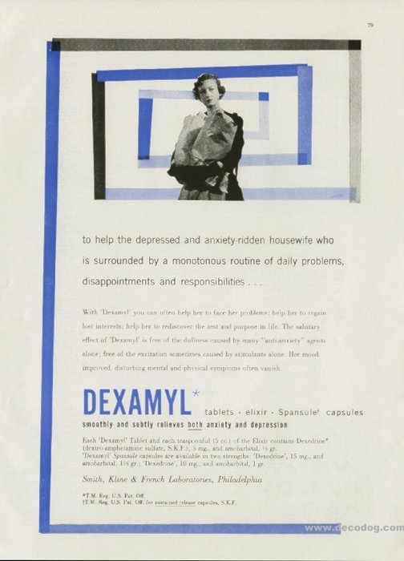
Meth
America’s love affair with speed
Copyright David Fawcett, PhD, LCSW

Slide 56
Meth & Sex
Mansergh (2004)
Meth users were twice as likely as nonusers to engage in unprotected receptive anal intercourse
Sildenafil users were 6.5 times more likely to report having had unprotected insertive anal intercourse.
Gay “party pack”
Meth, Viagra, Truvada
Copyright David Fawcett, PhD, LCSW

Slide 57
Meth + STDs
Studies from San Francisco and New York
show that MSMs who use crystal vs. non users are:
2-3X more likely to have HIV
6x more likely to have syphilis
2X more likely to have gonorrhea
Copyright David Fawcett, PhD, LCSW

Slide 58
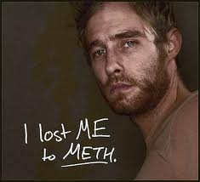
Causal Link between Meth and HIV
Long term MACS (Multicenter AIDS Cohort Study)
MSM using meth had 46% greater risk of becoming infected with HIV
MSM using poppers (93%)
and meth had 3x risk
Plankey MW, Ostrow et.al. The relationship between methamphetamine and popper use with HIV seroconversion in the Multicenter AIDS Cohort Study. J.Acquir Immune Defic Syndr. (published online ahead of print (March 29, 2007)
Copyright David Fawcett, PhD, LCSW

Slide 59
Meth and the internet
Sexual networking sites
PNP
Location-based
Utilized by law enforcement
Copyright David Fawcett, PhD, LCSW

Slide 60
Meth & HIV
The effect of methamphetamine [is] two or three times greater for individuals on combination therapy, especially combinations including ritonavir (Norvir)
CYP2D6
Halkitis, Parsons, and Stirrat (2001)

Slide 61
Meth & HIV Meds “an acceptable compromise”
Unplanned nonadherence
meth-related disruptions in eating and sleeping
Planned nonadherence
recognition that a rigorous medication schedule would not be maintained while using methamphetamine
concerns about mixing methamphetamine and medications.
Reback, Larkins, Shoptaw (2003)
Copyright David Fawcett, PhD, LCSW

Slide 62
Fusion of Meth and Sex
Neurons that “fire together wire together”
Focused attention
Reinforced through fantasy
New cognitive maps increase at expense of old ones (“vanilla” sex replaced by darker sex)
Increased desire vs ED (“crystal dick”)
Copyright David Fawcett, PhD, LCSW

Slide 63
Sex without Meth
Fusion of Behavior and Sex
“Since I've quit using I've been practically impotent. Sadly I don’t know [how sex could be better without crystal].”
Copyright David Fawcett, PhD, LCSW

Slide 64
Treatment

Slide 65
Treatment
Similar physical protocols
Need safe treatment environment
Overt/covert messaging by staff
Recognize drug-specific differences/ needs
Opiates versus amphetamines
Meth – for example, CBT “lite”
Ease of transfer – for example, process addictions
Copyright David Fawcett, PhD, LCSW

Slide 66
How is the LGBT recovery process different?
Issues for >6 months recovery
Physical recovery and co-occurring disorders
Shame and stigma
Sex and intimacy concerns
Rebuilding identity
Copyright David Fawcett, PhD, LCSW

Slide 67
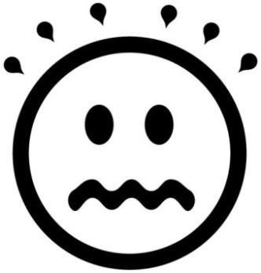
Physical Recovery and Co-Occurring Disorders
PAWS (Post Acute Withdrawal Syndrome)
Trouble thinking clearly/ concentrating
Mood swings; emotional overreaction or numbness
Memory problems
Sleep disturbances
Physical coordination problems
Difficulty managing stress
Rigid, repetitive thinking
Copyright David Fawcett, PhD, LCSW

Slide 68
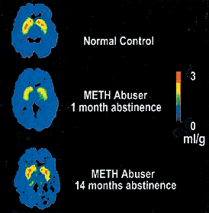
Physical Recovery and Co-Occurring Disorders
PAWS
Results from:
GABA-agonist (benzos, barbs, ethanol, GHB)
Opioid dependence
Amphetamine dependence (dopamine transporter system repair)
Duration 1 year to indefinite
Copyright David Fawcett, PhD, LCSW

Slide 69
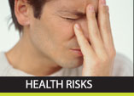
Physical Recovery and Co-Occurring Disorders
Layers of stigma - syndemics
HIV/AIDS
Physical concerns
Prescribed medications
Hepatitis
Treatment complications
Encephalopathy
Mental Health Concerns
Increased risk
Copyright David Fawcett, PhD, LCSW

Slide 70
Treatment and Supports
12 step programs
AA, NA, CMA
SMART Recovery
www.smartrecovery.org
Harm Reduction
www.harmreduction.org
Various levels of treatment
Copyright David Fawcett, PhD, LCSW

Slide 71
Tool kit
Stages of Change
Precontemplation
Contemplation
Preparation
Action
Maintenance
Motivational Interviewing
Copyright David Fawcett, PhD, LCSW

Slide 72
Psychosocial Co-Factors
Social Disinhibition
Cope with negative social meanings of gay
Second “coming out”
Overcome inhibition
Particularly sexual
Conflicting social norms
Social activities involving substances
Copyright David Fawcett, PhD, LCSW

Slide 73
Psychosocial Co-Factors
Identity
Slammers
Clubkids
Tribe
Barebackers
Obtain self esteem through sex
Boredom
Copyright David Fawcett, PhD, LCSW

Slide 74
Psychosocial Co-Factors
Shame
Long term
Internalized Homophobia
Relationship with self
“No fats, no fems”
“No fakes, no flakes, no fruity-cakes”
“Str8 acting UB2”
“d/d free”
Copyright David Fawcett, PhD, LCSW

Slide 75
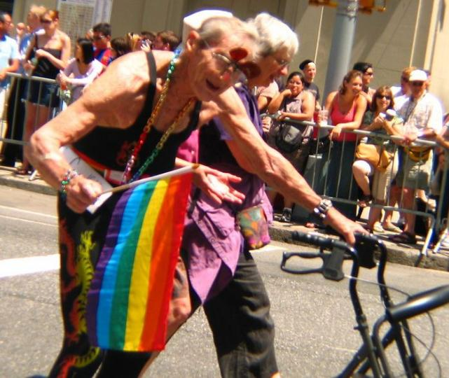
Psychosocial Co-Factors
Dealing with feelings
Cognitive Escapism and Social Leveling
Loneliness
Attractiveness
Ageism
Copyright David Fawcett, PhD, LCSW

Slide 76
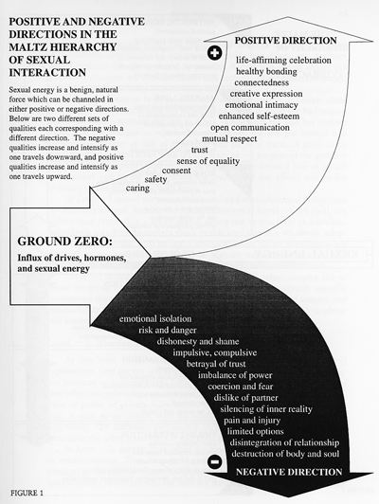
Sex
What is healthy sex?
Copyright David Fawcett, PhD, LCSW

Slide 77
Psychosocial Co-Factors
Intimacy
Romance is not intimacy
Limerance
Oxytocin, vasopressin
LUST
LOVE
LUST
LOVE
Copyright David Fawcett, PhD, LCSW
Notes:
QUESTIONS?

Slide 78
Beliefs about intimacy
“Tell me who you want me to be”
“If you really knew me you’d go away”
“I don’t know how”
“I can only say no” or “I can ever say yes”
“Relationships are made in heaven”
Copyright David Fawcett, PhD, LCSW

Slide 79
Rebuilding Identity

Slide 80
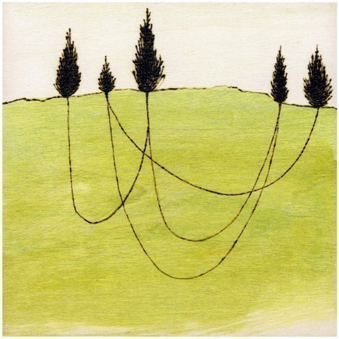
Build Connections
Friendships and Community
Need non-commercial connections
NSBF (no sex best friend)
Good and bad of the internet
Recreation
Copyright David Fawcett, PhD, LCSW

Slide 81
Move Beyond Labels
Copyright David Fawcett, PhD, LCSW
Noodlesandbeef.com

Slide 82
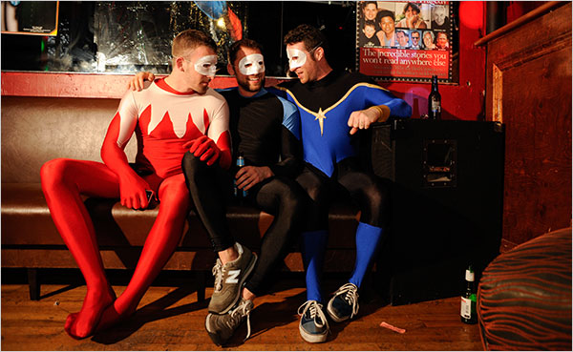
Build Interpersonal Strengths
Social Bonding
Sense of Community
Practice Dating/Sex/Intimacy/Relationships
Healthy Sense of Being LGBTQI…
Spirituality
Copyright David Fawcett, PhD, LCSW

Slide 83
Case Study Part 2

Slide 84
The Role of the Professional

Slide 85
The Professional
Professional characteristics to treat LGBT addiction:
Which are helpful?
Which are necessary?
Copyright David Fawcett, PhD, LCSW

Slide 86
Reframe from deficits-based to strengths-based
From victim to empowered
Deficits-based approaches
Raise condom use skills
(gay men don’t know how to use condoms)
Raise condom negotiation skills
(gay men don’t know how to negotiate sex)
Change peer norms
(gay men have unhealthy peer norms, esp. around sex)
Raise skills to face homophobia
(gay men have few skills to face homophobia)
Copyright David Fawcett, PhD, LCSW

Slide 87
Strengths-based approaches (resilience)
Gay men quit smoking at high rates.
LGBTs report low levels of
problematic drug use given
exposure rates.
LGBTs can resolve heavy substance use over time.
Large proportions of gay men stay seronegative for decades on end, even while enjoying a very active sexual life
Copyright David Fawcett, PhD, LCSW

Slide 88
Surveys of LGBT Substance Abuse Clients
Copyright David Fawcett, PhD, LCSW

Slide 89
LGBT opinions about treatment
Address substance abuse and sexual orientation directly, rather than wait for clients to bring it up
Be knowledgeable about addiction and sexual orientation and how these two interact.
Provide gay/lesbian specific meetings and groups, which provide opportunities for sober role models (connection, identification, and safety)
Copyright David Fawcett, PhD, LCSW

Slide 90
Opinions about treatment
Most effective treatment helped clients move through shame to self acceptance
Shame of addiction and also homosexuality
An atmosphere of acceptance was felt to be particularly healing.
Be sensitive to client struggling whether or not they can safely come out to staff and peers
One cannot work an honest program if he/she is not real about who they are.
Copyright David Fawcett, PhD, LCSW

Slide 91
Opinions about Treatment
Know the social context of alcohol and drugs within the gay community.
Be aware of the high risk of suicide in the gay community
One man hospitalized himself for suicidal depression and the facility addressed neither his addiction nor his sexual orientation.
Copyright David Fawcett, PhD, LCSW

Slide 92
Opinions about Treatment
Be aware of one’s own internalized homophobia
Be cognizant of verbal and non-verbal cues of acceptance or rejection.
Recognize the importance of
family, however it is defined
Questionnaires were typically
reflective of families of origin
or heterosexual unions.
Copyright David Fawcett, PhD, LCSW

Slide 93
Thank you!
David Fawcett PhD, LCSW
2655 East Oakland Park Blvd, Suite 2
Fort Lauderdale, Florida 33306 954.776.3639
davidfawcett@earthlink.net
www.david-fawcett.com

